Slide 1
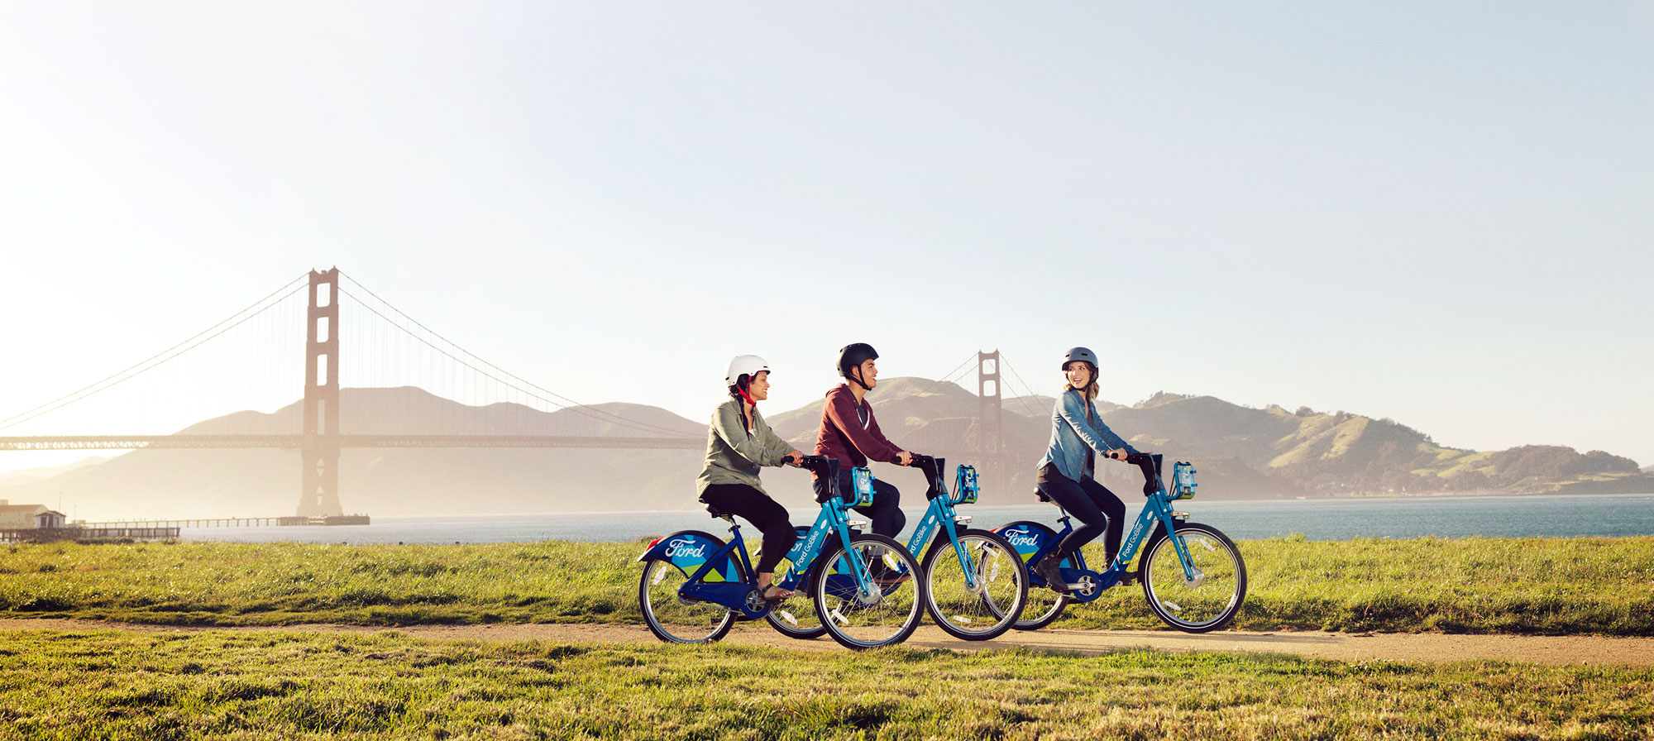
Where’s my bike?
Daniel Turse
2019-04-23
Predicting Bikeshare Availability in the San Francisco Bay Area

Slide 2
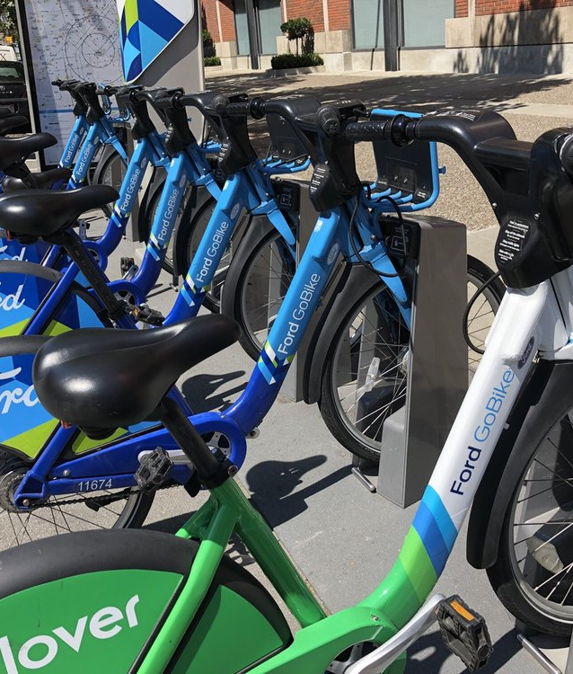
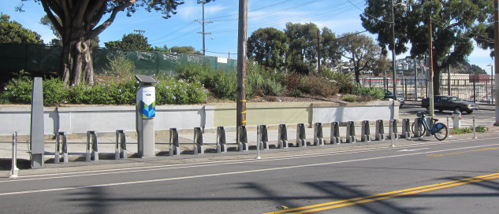
What are we talking about?
Putting some data science around:
Is there going to be a
bike at the dock when I
get there?

Slide 3
Data & DC
Trip Data
Availability Data
https://www.capitalbikeshare.com/system-data
Start Datetime
Start Station
End Station
End Datetime
Member Type
https://feeds.capitalbikeshare.com/stations/stations.xml
Station
Datetime
Num Bike Available
Num Docks Available
Notes:
Related – can’t take a trip without there being a bike available. But the Trip Data, doesn’t provide adequate info on availability.
Availability Data is an XML snapshot…so not really suitable for analyses…unless you pinged the snapshot regularly (e.g., every minute) to collect historical data
EXISTING HISTORICAL DATA THAT I KNOW ABOUT
NYC: https://www.theopenbus.com/raw-data.html
SF: https://www.kaggle.com/benhamner/sf-bay-area-bike-share/version/1
From Wikipedia (htts://en.wikipedia.org/wiki/Ford_GoBike), the original Bay Area Bike Share began in Aug 2013

Slide 4


Bike Availability?
Availability

Slide 5
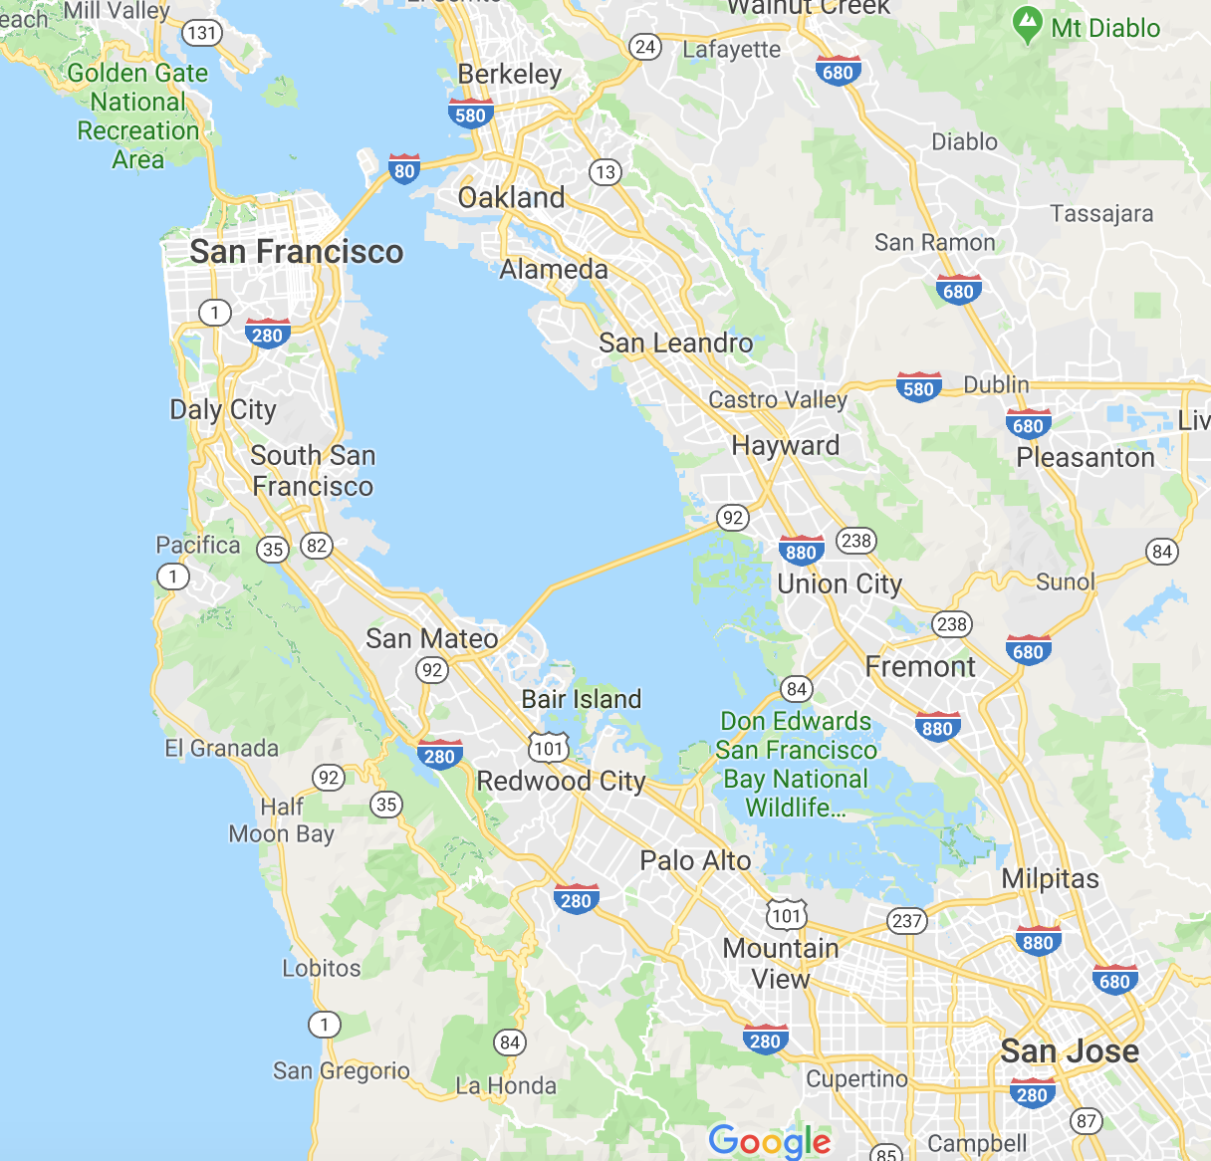
Data &
DC
San Francisco
Trip Data
Availability Data
https://www.capitalbikeshare.com/system-data
Start Datetime
Start Station
End Station
End Datetime
Member Type
https://feeds.capitalbikeshare.com/stations/stations.xml
Station
Datetime
Num Bike Available
Num Docks Available

Slide 6
Objectives
Forecasts of bike availability
For each dock (70 to 6)
For the next 5, 10, and 15 minutes
Compare forecasts by accuracy and run time
Explore variable importance

Slide 7

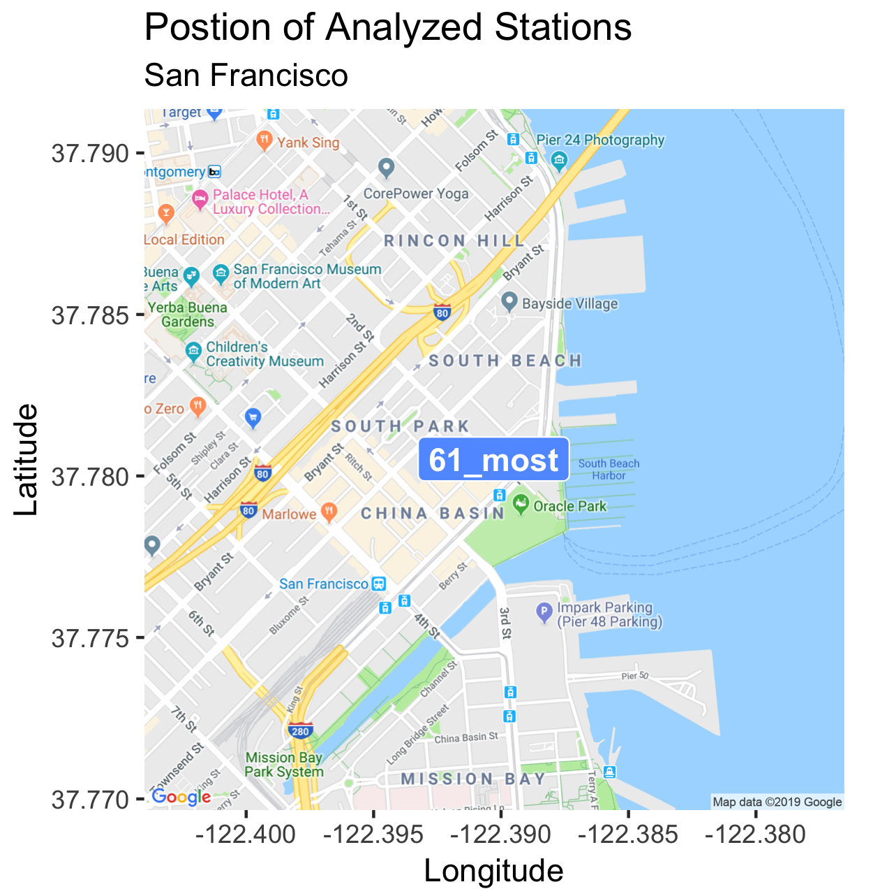
What can the data tell us?

Slide 8
Forecast Overview
7 different combinations of algorithms tried
+ a baseline
Variables based on
Past availability
Calendar/time

Slide 9
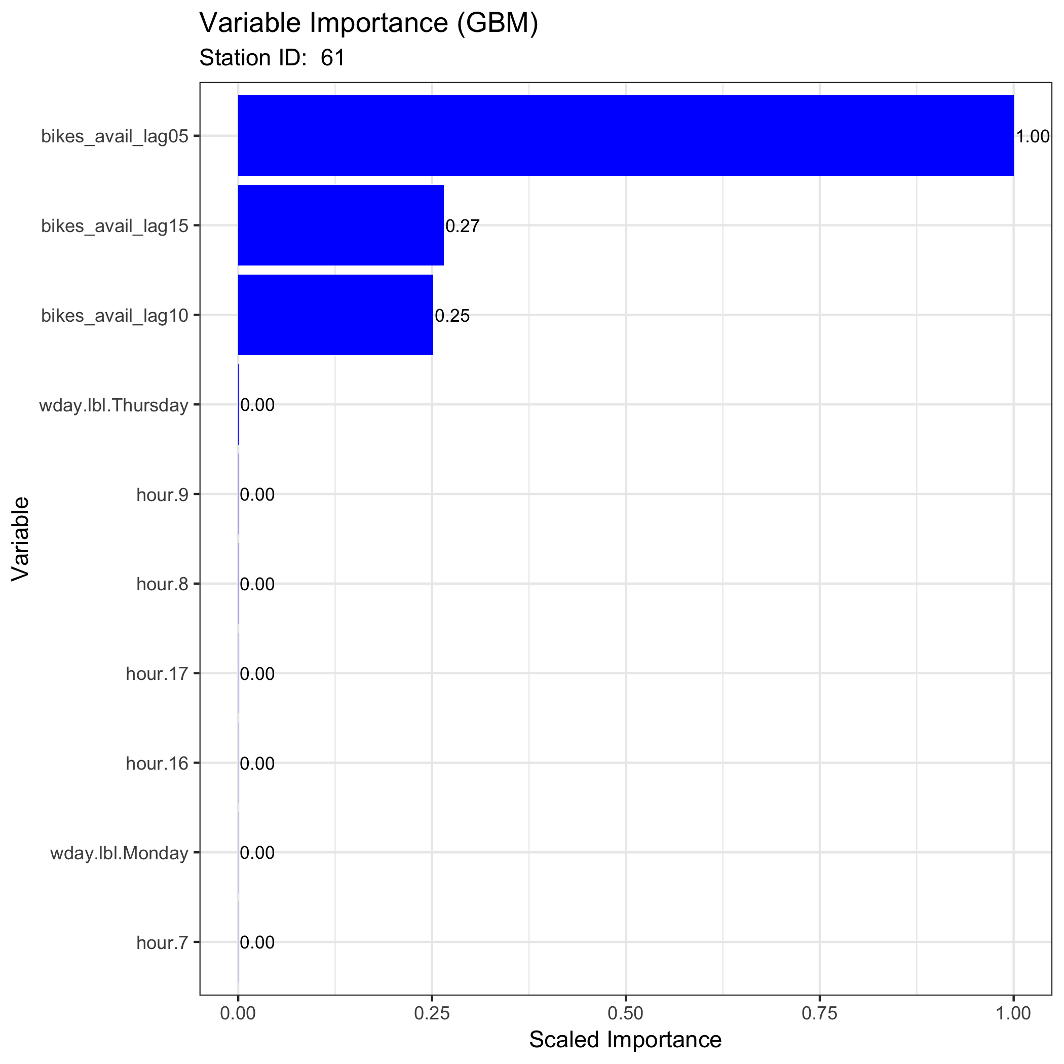
Results – Variable Importance

Slide 10
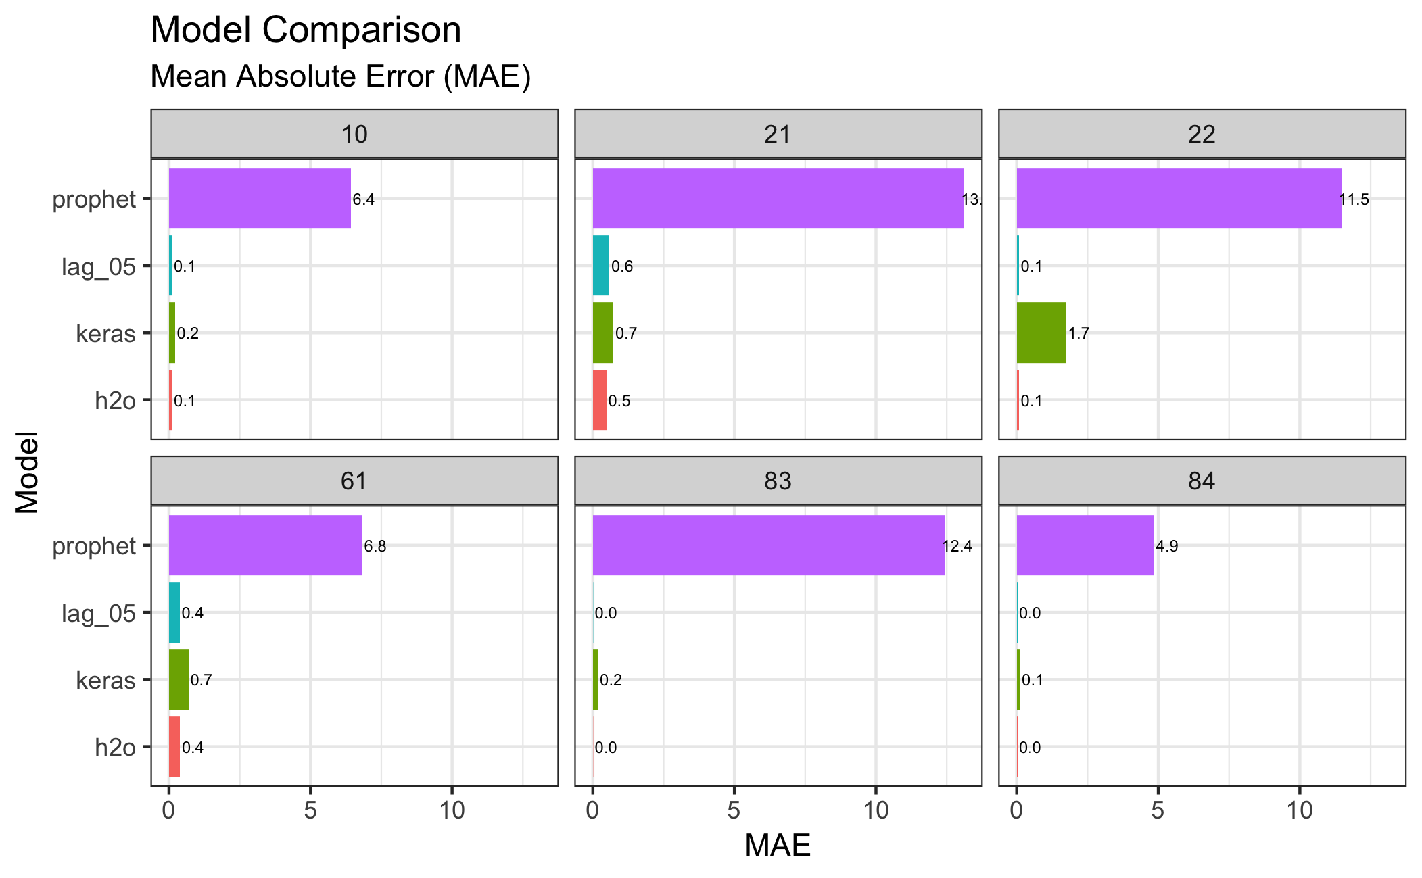
Results – Model Comparison

Slide 11
Results – Actual vs. Prediction

Slide 12
Conclusion & Future Plans
Conclusions
H2O & Keras (LSTM) models are powerful…but…
Always create a “simple” baseline!
Future
General model tuning
Predict dock availability
Contact Info
turse.mda@gmail.com
linkedin.com/in/mdaturse/
github.com/supermdat/Bikeshare_Status_SF
@MDATurse

